Slide 1














PAYMENT PREFERENCES:
EXPLORING NYC YELLOW TAXI TRENDS THROUGH DATA
Presented by SIddhant Ghosh

Slide 2
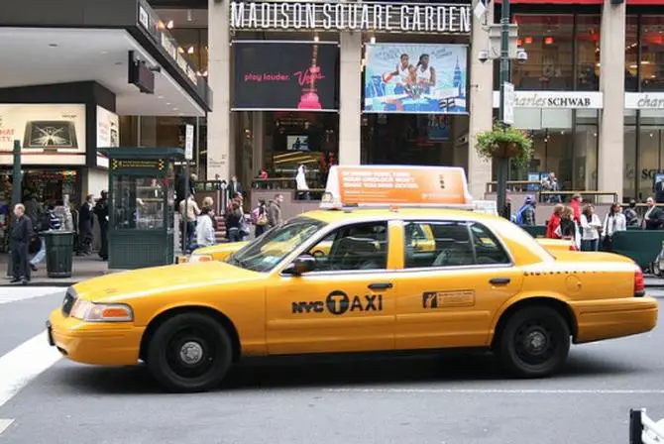
AGENDA
PROBLEM STATEMENT
RESEARCH QUESTION
DATA OVERVIEW
METHODOLOGY
ANALYSIS AND FINDING
HYPOTHESIS TESTING
RECOMMENDATIONS

Slide 3
PROBLEM STATEMENT
In the competitive taxi booking industry, optimizing revenue is crucial for both long-term success and driver satisfaction. Our objective is to leverage data-driven insights to maximize revenue streams for taxi drivers. Specifically, we aim to investigate whether the choice of payment method influences fare pricing by analyzing the relationship between payment type and fare amount.

Slide 4
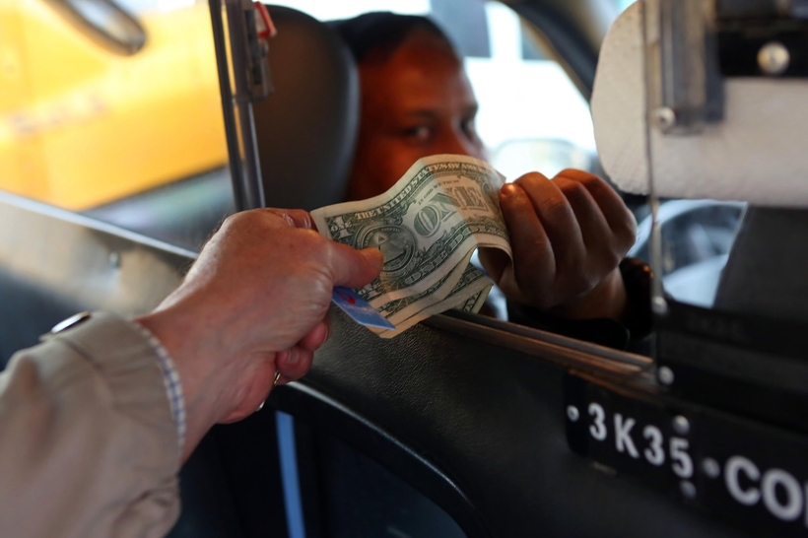
RESEARCH QUESTION
Does the payment method (cash vs. card) affect the fare amount in NYC Yellow Cabs?
In the highly competitive taxi industry, understanding how payment methods influence fare pricing is crucial for optimizing revenue.
This research seeks to explore if there are significant differences in fare amounts between cash and card payments, which could inform pricing strategies for taxi services.
Do customers who pay with cash leave different average tips compared to those who pay with a card?
Tips represent a vital source of income for taxi drivers, and payment methods may impact customer tipping behavior.
This research examines whether cash-paying customers tend to leave higher or lower tips compared to card payers, offering insights into customer behavior and potential avenues for maximizing driver earnings.

Slide 5
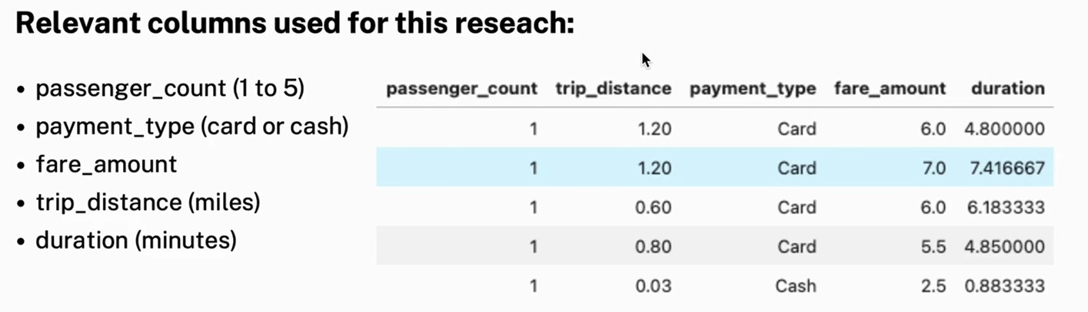
DATA OVERVIEW
For this analysis, we utilized the comprehensive dataset of NYC Yellow Cabs, employed data cleaning and feature engineering procedures to focus solely on the relevant columns essential for our investigation.

Slide 6
METHODOLOGY
Step | Description
Descriptive Analysis | Performed statistical analysis to summarize key aspects of the data, focusing on fare amounts and payment types.
Hypothesis Testing | Conducted a T-test to evaluate the relationship between payment type and fare amount, testing the hypothesis that different payment methos influence fare amounts.
Regression Analysis | Implemented linear regression to explore the relationship between trip duration (calculated from pickup and dropoff times) and fare amount.

Slide 7
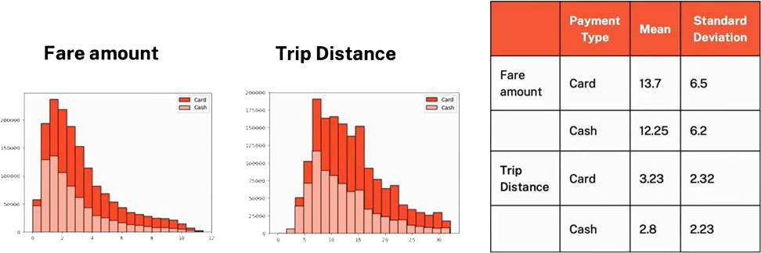
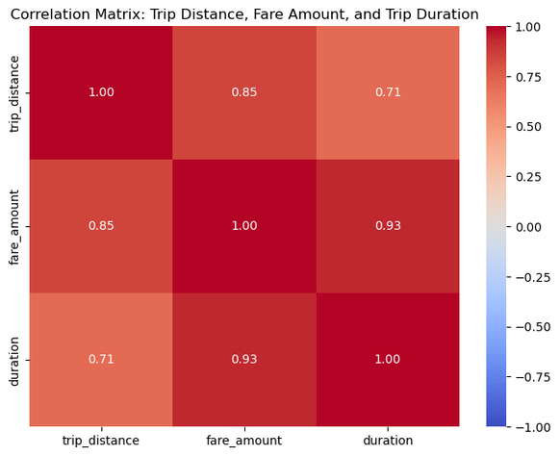
INSIGHTS
Customers paying with cards tend to have a slightly higher average trip distance and fare amount compared to those paying with cash.
Indicated that customers prefer to pay more with cards when they have high fare amount and long trip distance.
The data suggests that longer trips (both in terms of distance and duration) tend to result in higher fares.

Slide 8
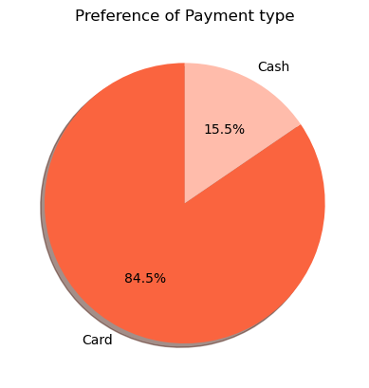
PREFERENCE OF PAYMENT TYPE
The proportion of customers paying with cards is significantly higher than those paying with cash, with card payments accounting for 84.5% of all transactions compared to cash payments at 15.5%.
This indicates a strong preference among customers for using card payments over cash, potentially due to convenience, security, or incentives offered for card transactions.

Slide 9
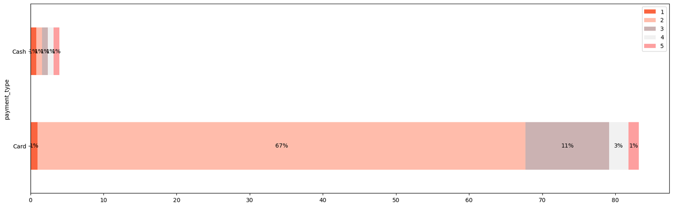
PASSENGER COUNT ANALYSIS
Among card payments, rides with a single passenger (passenger_count = 1) comprise the largest proportion constituting 62% of all card transactions.
Similarly, cash payments are predominantly associated with single-passenger rides, making up 11.04% of all cash
transactions.
There is a noticeable decrease in the percentage of transactions as the passenger count increases, suggesting that larger groups are less likely to use taxis or may opt for alternative payment methods.
These insights emphasize the importance of considering both payment method and passenger count when analyzing transaction data, as they provide valuable insights into customer behavior and preferences.

Slide 10
HYPOTHESIS TESTING - I
Null hypothesis: There is no difference in average fare between customers who use credit cards and customers who use cash.
Alternative hypothesis: there is a difference in average fare between customers who use credit cards and customers who use cash
With a T-statistic of 246.53 and a P-value of less than 0.05, we reject the null hypothesis, suggesting that there is indeed a significant difference in average fare between the two payment methods.

Slide 11
HYPOTHESIS TESTING - II
Null hypothesis: There is no difference in average tip between customers who use credit card and customers who use cash.
Alternative hypothesis: There is a difference in average tip between customers who use credit card and customers who use cash.
The T-statistic of -0.16 and p-value of 0.87 suggest that there is no statistically significant difference between the two groups being compared. The high p-value (> 0.05) indicates that we fail to reject the null hypothesis.

Slide 12



RECOMMENDATIONS
Encourage customers to opt for credit card payments to maximize revenue opportunities for taxicab drivers.
Implement strategies like offering incentives or discounts upto 10-15% for credit card transactions to motivate customers to choose this payment method.
Ensure seamless and secure credit card payment options to enhance customer convenience and promote the adoption of this preferred payment method.

Slide 13
Thank you very much!
Portfolio Link

